Slide 1
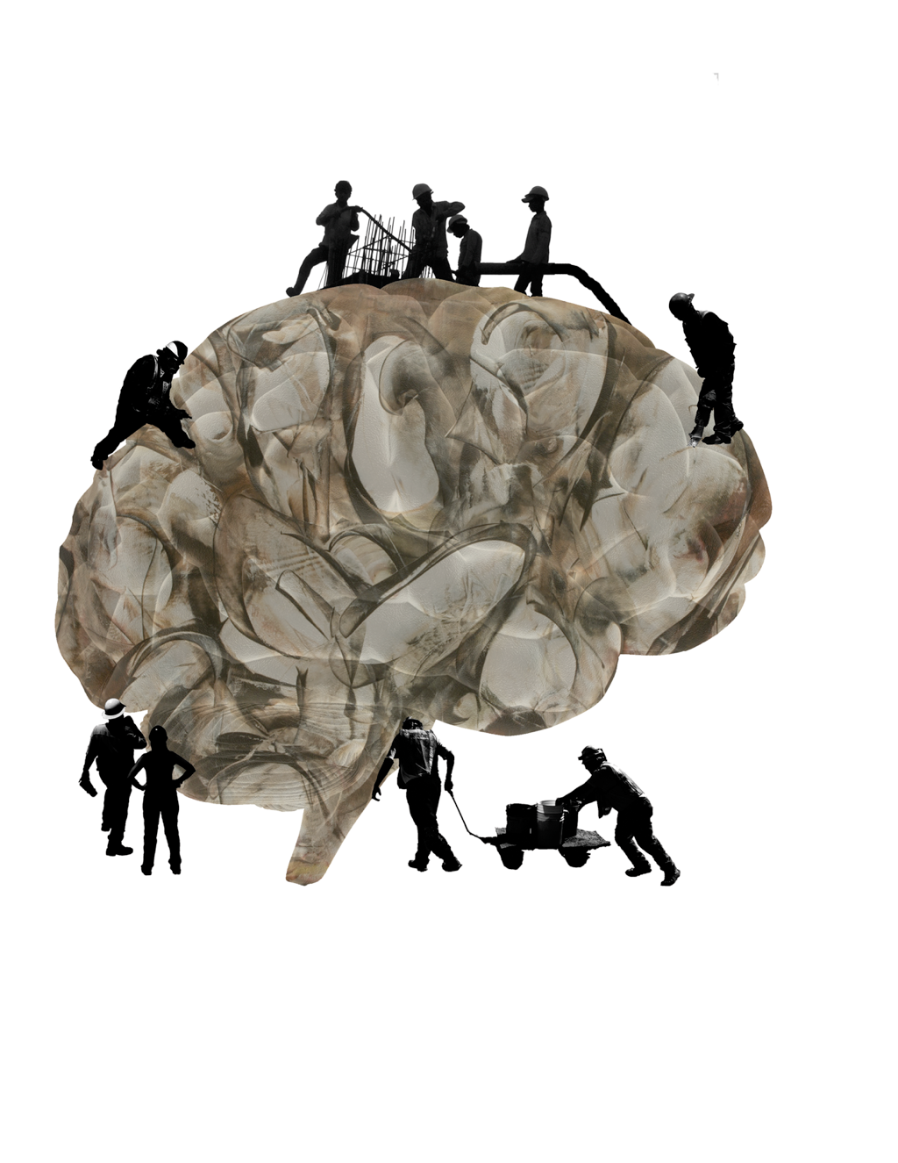

Spatial Semantic Pointers (SSPs)
Chris Eliasmith
SYDE 556/750
Notes:
- reluctant to pursue real research interests, not respectable
- so built lots of models: lamprey swimming, working memory, path integration in the rat, neural integrator for eye control, various decision circuits

Slide 2
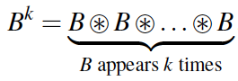
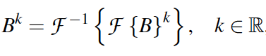
Spatial Semantic Pointers
Semantic pointers represent standard discrete structures (lists, trees, etc.)
SSPs allow recurrent convolutions to have fractional powers
Compute fractional k in Fourier space

Slide 3
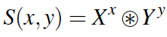
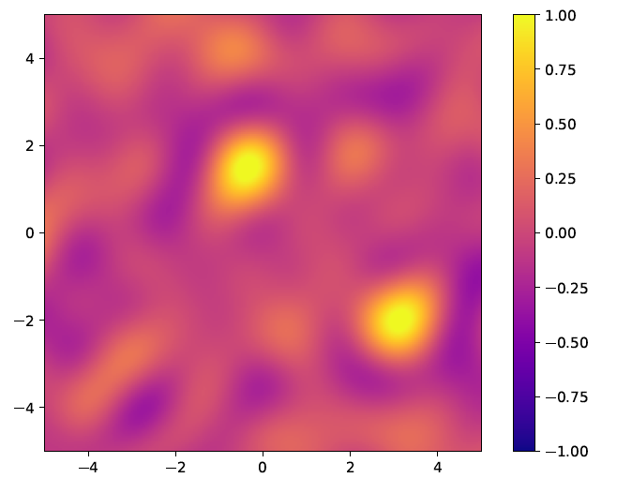
Spatial Semantic Pointers
Represent continuous space (Clifford torus)
Heat map to visualize vector contents
Dot product between SSP at every possible position and S
Notes:
Clifford torus: preserves Euclidean geometry. This is a generalization to any number of dimensions of the torus (usually just 4D); ‘proper’ cartesian product of circles (not a 3 torus)

Slide 4
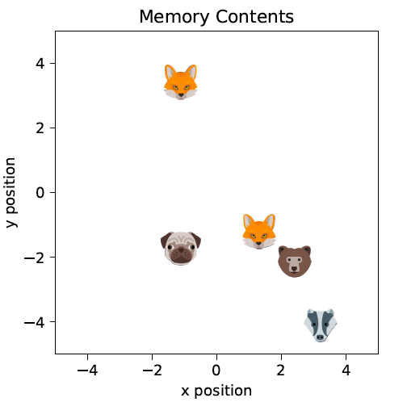
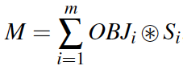
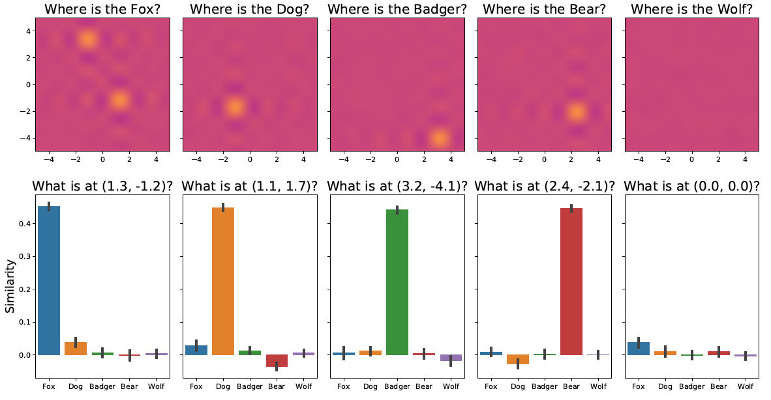

Slide 5
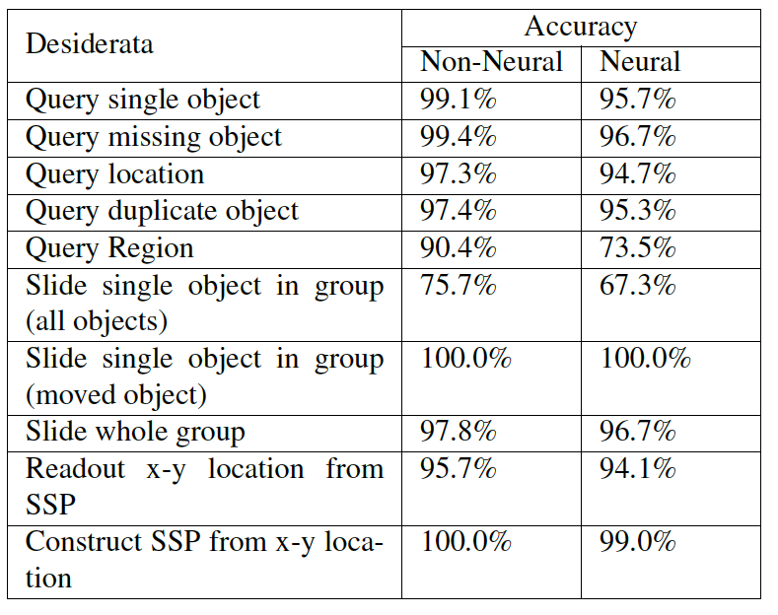
Spatial Manipulations

Slide 6
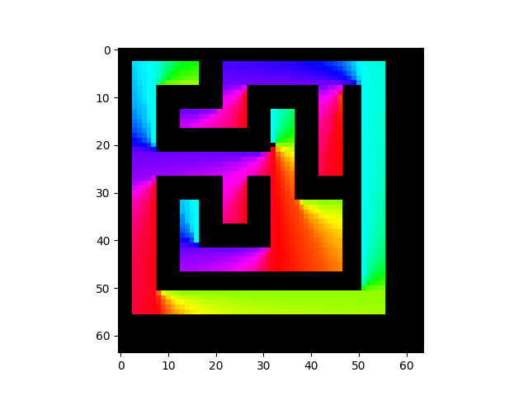
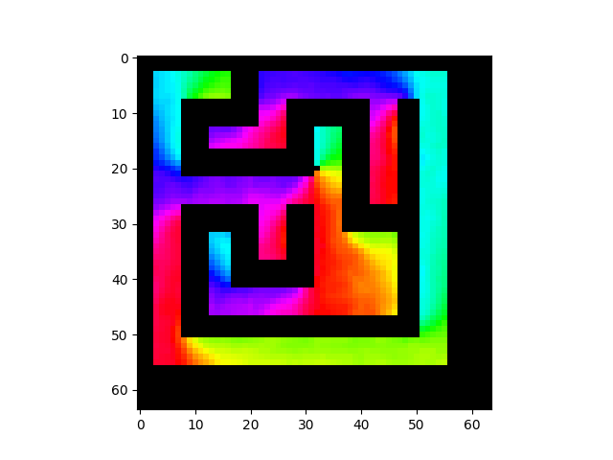
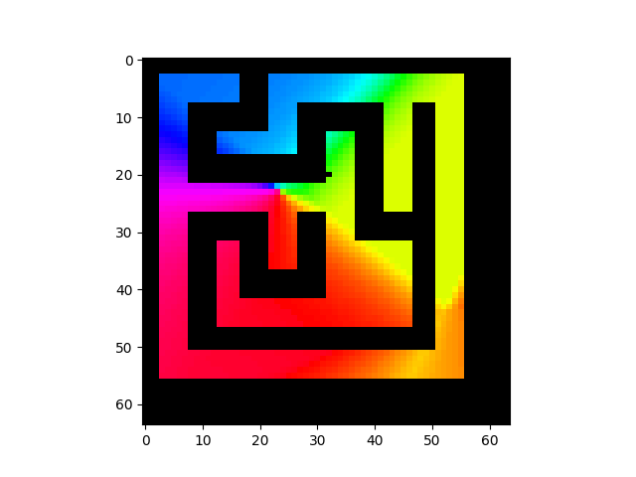

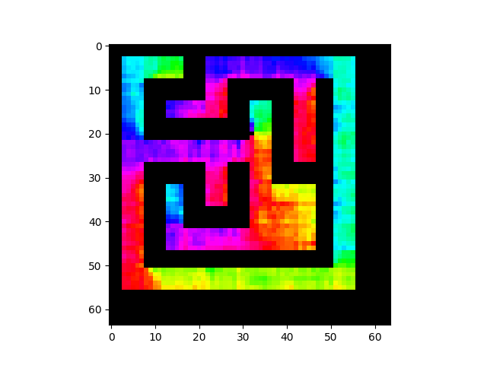
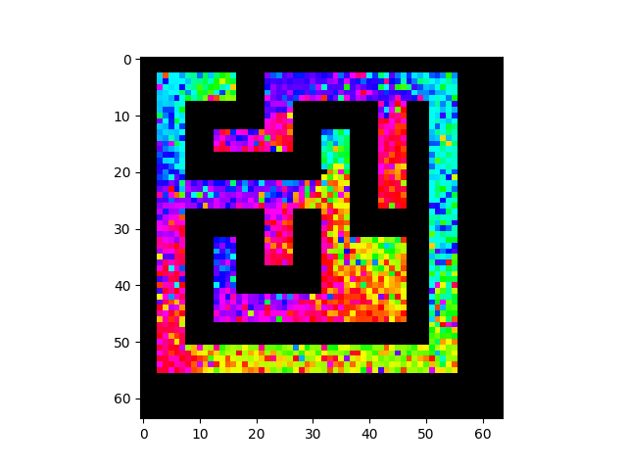
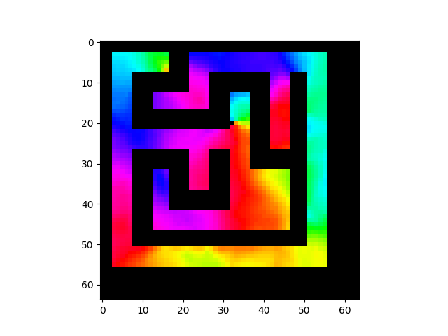

Navigating to Goal
Ground Truth
RMSE: 0
SSPs
RMSE: 0.0529
Random Projection
RMSE: 0.5351
Single layer MLP, same for each encoding (tried many more).
Trig Functions
RMSE: 0.1350
Random Mapping
RMSE: 0.2580
2D Coordinates
RMSE 0.1984
Legend
Up
Left
Right
Down
Notes:
Keep diagram on this slide, and explain the different methods

Slide 7
Scaling
Example 10x10 joined, hierarchical environment

Slide 8
Scaling
Performance of different encoders on 10x10 large maze from any point to any other

Slide 9
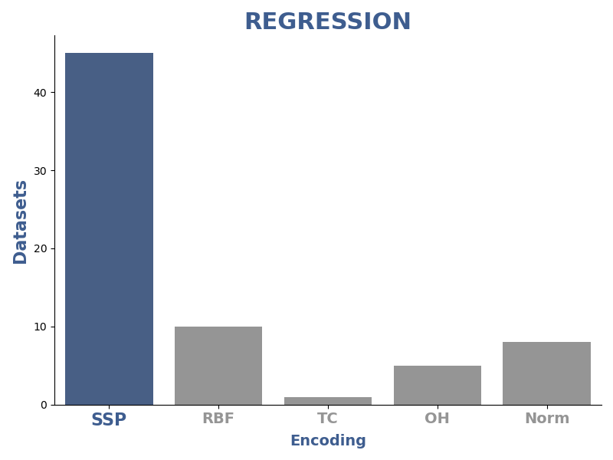
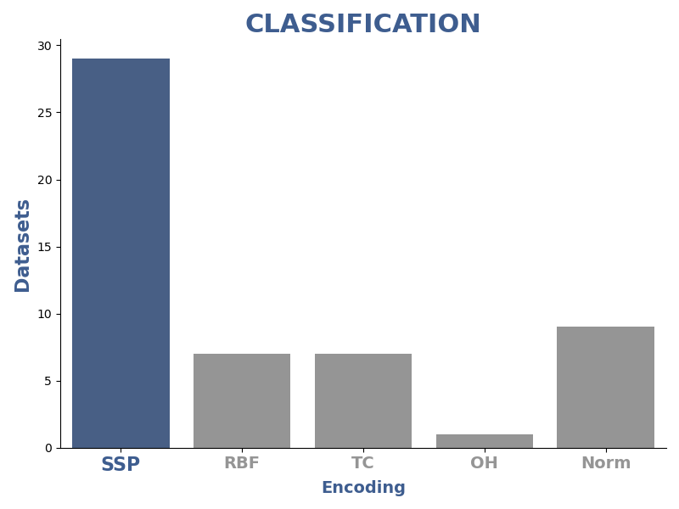
Good for General ML
SSPs are more accurate on a large majority of 122 standard ML benchmarks.

Slide 10
How to Choose Axis Vectors
Randomly (examples til now)
Tuning curves of neurons with random axis vectors and evenly tiled SSPs as encoders

Slide 11
How to Choose Axis Vectors
With plane wave structure
Tuning curves of neurons with structured axis vectors and encoders picking out plane waves

Slide 12
How to Choose Axis Vectors
Sums of planar waves

Slide 13
Grid Cells
With plane wave structure, spiking neurons give grid cell responses
We can combine them to get place cells (with standard NEF decoders)
SSP Grid cells

Slide 14
Place Cells

Slide 15
Mathematical properties
Euclidean space is preserved on a high-d torus
E.g.,
We get the benefits of high-d representation, with accurate low-d Euclidean representation

Slide 16
Cognitive SLAM
SLAM with complex features at certain spatial locations
Start with no knowledge, bind vector descriptions to particular location in space
Combines spatial and ‘symbol’ repn in neural network
Semantic map as opposed to standard ‘image registration’ map

Slide 17
Cognitive SLAM Model
Full Model
Path Integrator
Path integrator tracks ego position from velocity
SLAM model learns env map, outputs allo- and ego-centric position

Slide 18
Path Integration
One-minute long paths in 2D and 3D, spiking network

Slide 19
Cognitive SLAM
Learns env by end of 20s path, full spiking
Scaling up; symbols ‘over’ space
Notes:
(a) The path and
items along it (marked by coloured shapes). The ‘x’ markers
indicate recalled item locations at the end of the simulation.
(b) The error in recollection of the item locations as SSPs over
time, where the error is equal to the absolute value of the difference
between one and the similarity of the recalled vector
to the true vector. The markers on the time axis show when
the items appeared along the path. (c) Error in the model’s
estimate of the vector between items and self-position.

Slide 20
Cognitive SLAM
Learns maps in LTM bound to position

Slide 21
Navigation network
Combined all of the above into a network to recall location and navigate to arbitrary objects in a maze.

Slide 22
SSPs as Probabilities
SSPs can be a method for encoding and processing probabilities
Method directly connects neural networks to probabilistic reasoning
SSP based methods are efficient

Slide 23
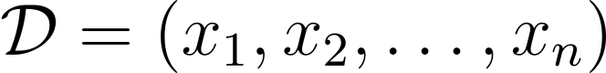
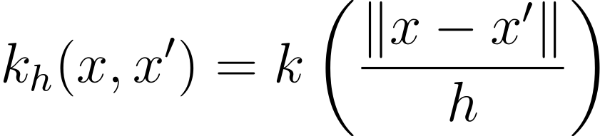
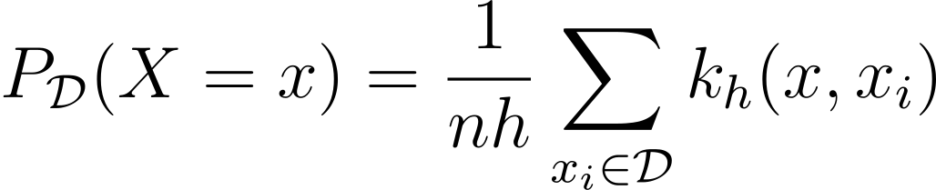
SSPs as Probabilities
Background
Kernel Density Estimators
From a dataset
With a kernel function
We can estimate the probability of x

Slide 24
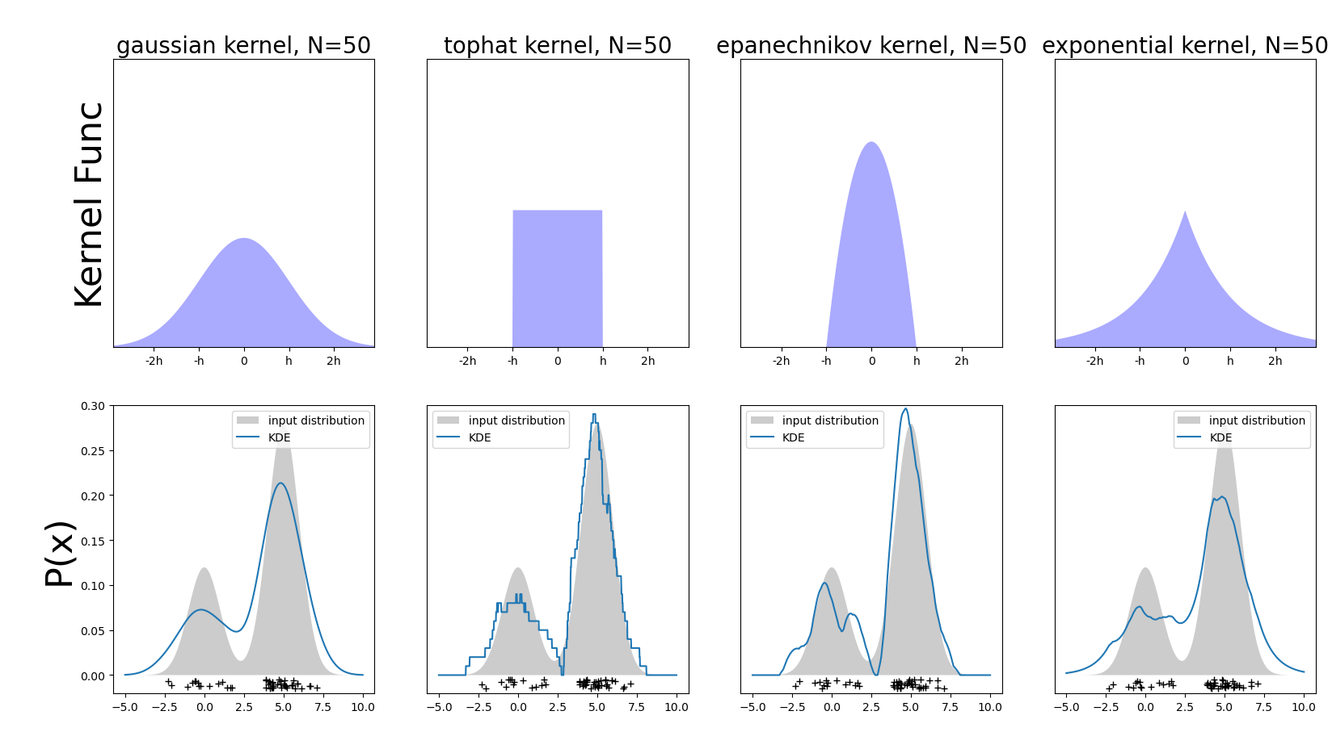
SSPs as Probabilities
Kernel Density Estimators Examples

Slide 25

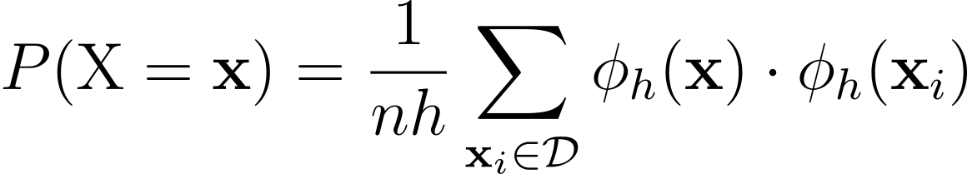
SSPs as Probabilities
Problems
KDE memory grows linearly with the number of observations
KDE time to compute a probability grow linearly with # of observations
But…
Not if your kernel is a dot product

Slide 26
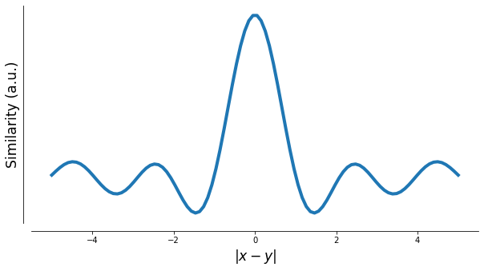
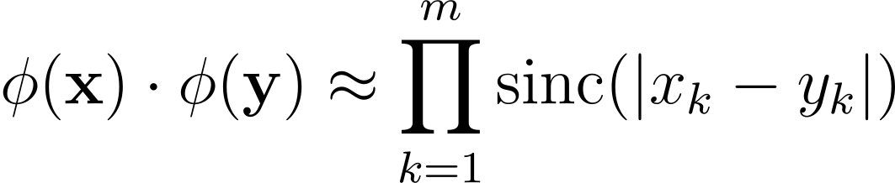
SSPs as Probabilities
SSPs induce a quasi-kernel
‘quasi’ because there are negatives

Slide 27

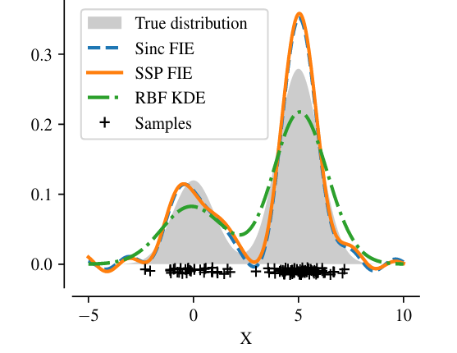
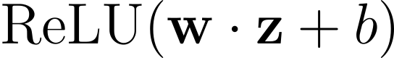
SSPs as Probabilities
Can convert to probability estimator
Glad et al, 2003

Slide 28
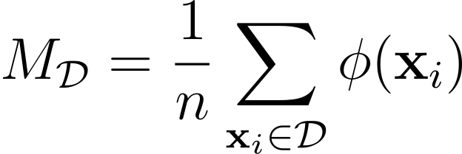

SSPs as Probabilities
So SSP memory is a latent probability distribution
The distribution is stored in bundles of vector symbols.
We can apply manipulations to bundles to produce probabilistic statements

Slide 29

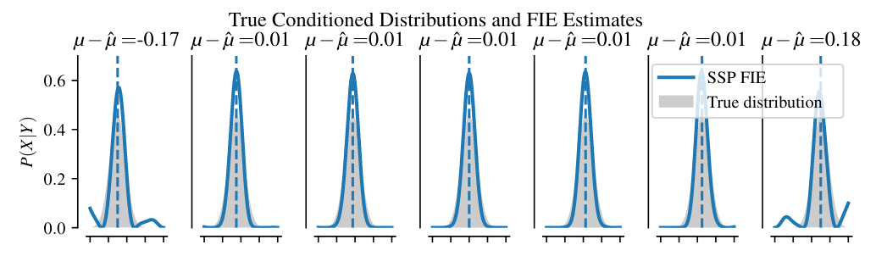
SSPs as Probabilities
Conditioning

Slide 30
SSPs as Probabilities
Mutual Information (MI) is a common objective function used in exploration
Gaussian Processes (GPs) are a convenient, but computationally intensive tool for computing MI
We use Spatial Semantic Pointers and Bayesian linear regression to approximate a GP while improving in memory and time complexity
μ_{t}(x)
σ²_{t}(x)

Slide 31
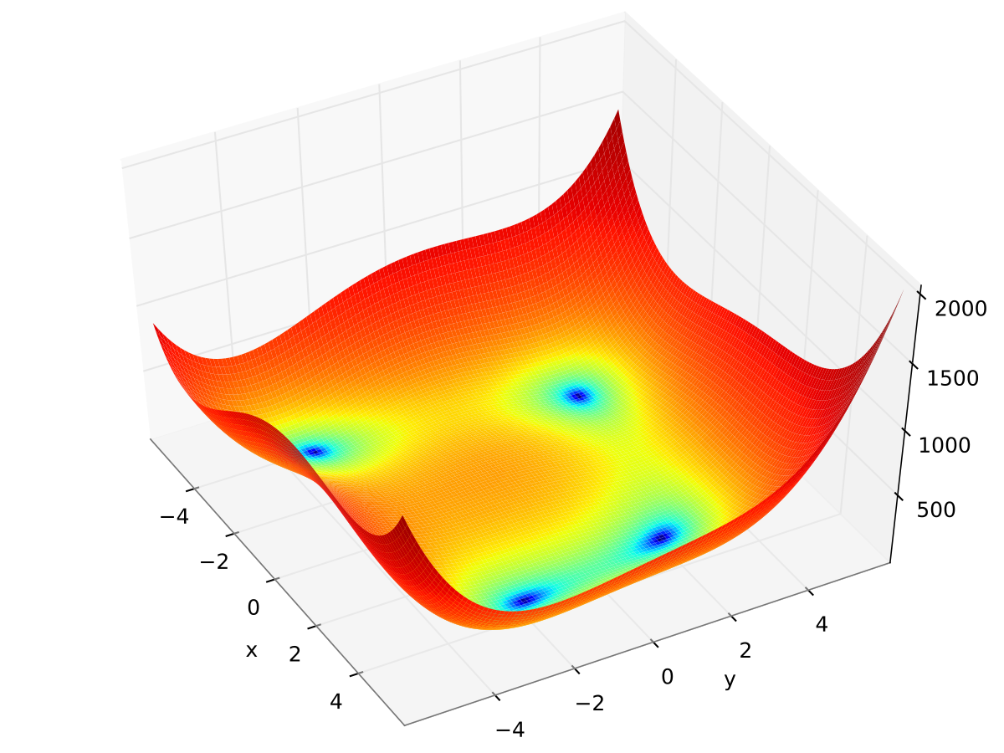
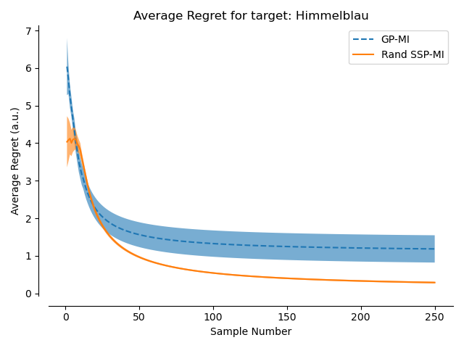
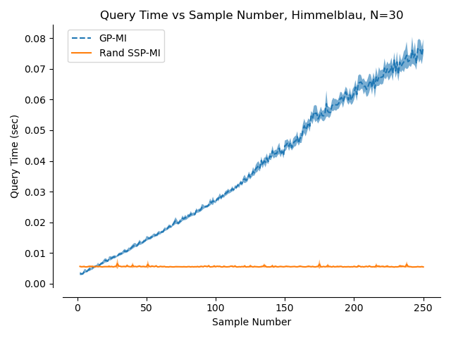
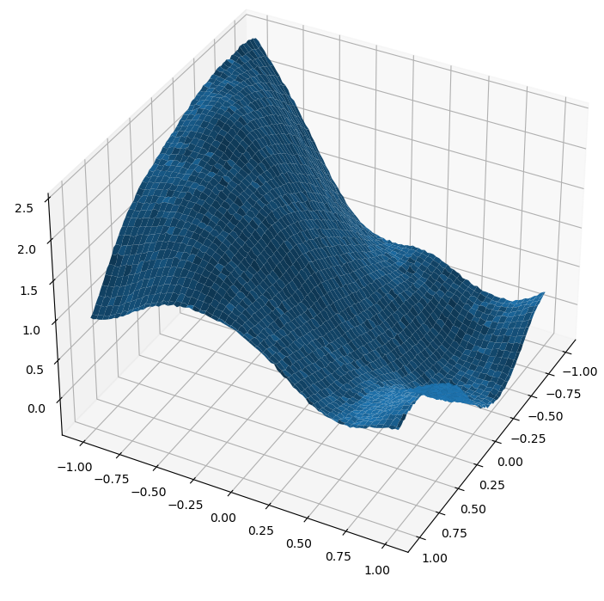
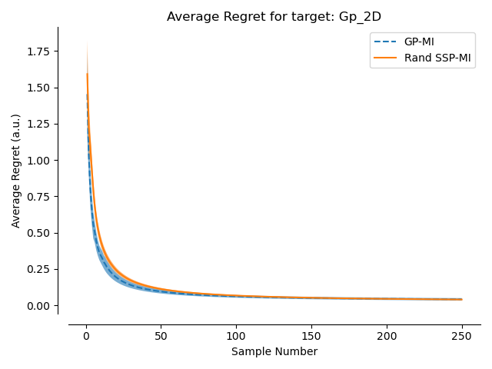
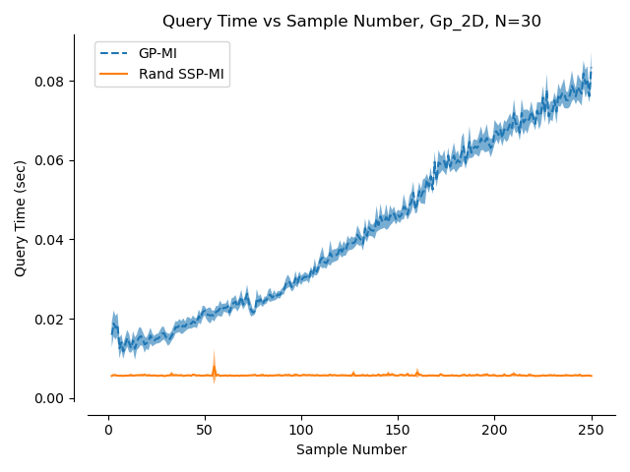
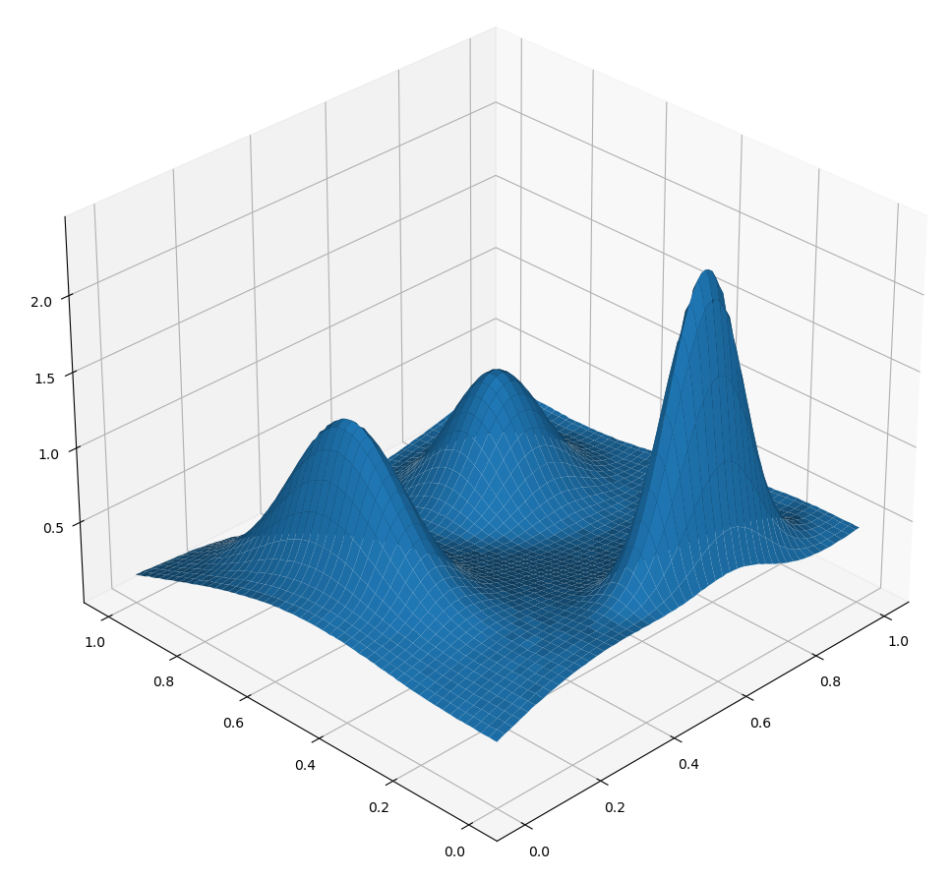
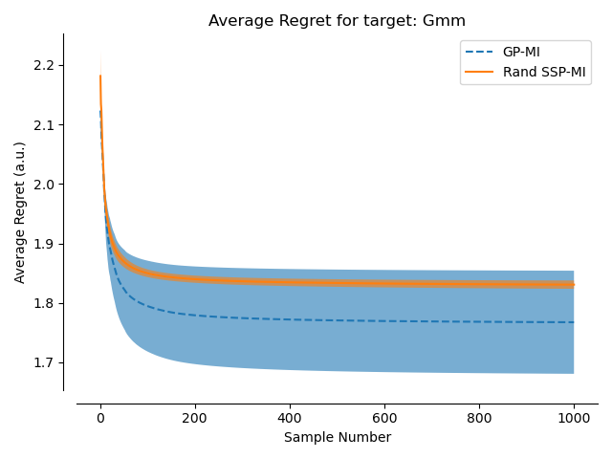
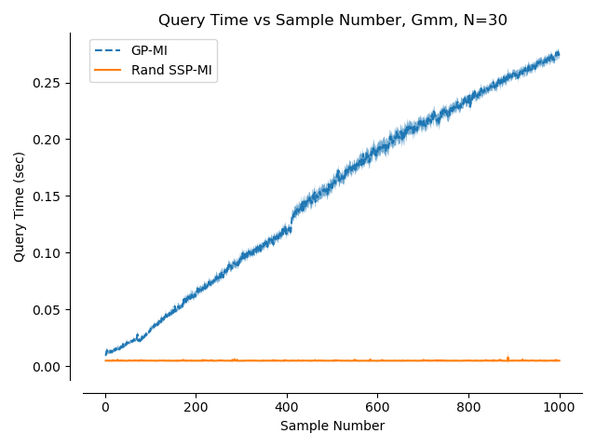
Results
Himmelblau Function
Sampled from GP with Matern Kernel + 1% noise
GMM with noise ~ (Matern Kernel + 1% noise)

Slide 32
SSPs as Probabilities
Where we differ:
Provide a general and abstract framework for modelling probabilities
Draw a direct connection between cognitive models and probability statements
Provide network architectures for conditioning, marginalization, entropy, and mutual information

Slide 33
Conclusion
SSPs support a variety of types of inference for cognitive models
Binding spatial and ‘symbolic’ representations
Representations of sampled data that can be used for probabilistic inference
Improves
Interpretability
Efficiency (SWaP critical)
Best engineered systems continue to learn from understanding biological solutions

